Slide 1
PREDICTING HOTELS PRICES IN SAUDI ARABIA BY USING MACHINE LEARNING
DEEP DIVERS TEAM
Fatimah Al Yami
Lubna Aldosari
Sawsan Aljawni
Monyah Aladeli

Slide 2


The outlines:
Introduction and Business problem
Data Description
Data Preprocessing
Exploratory Data Analysis (EDA)
Modeling & Results
Conclusion and future work

Slide 3
Introduction

Slide 4

As one of the largest and fastest-growing economic sectors in the world, the tourism sector is at the forefront of the Kingdom's Vision 2030.
Investment in the tourism sector will contribute to increasing the country’s GDP from its current rate of 3% to more than 10% by 2030 and create thousands of jobs in the tourism sector by 2030. In addition to attracting local and international visits annually by 2030.
For this reason and given the importance of the tourism sector in the Kingdom at the present time, we chose in our project to process hotel prices, which greatly affects the satisfaction and attraction of tourists.
As well as studying prices to remove obstacles to citizens and attract them internally instead of traveling abroad.

Slide 5
Data Description

Slide 6


Dataset extracted from Kaggle.
Data collected from booking from 29- April to 1-May 2020.
Provides accurate statistics for hotels in different regions of the Kingdom of Saudi Arabia, as it contains 1026 rows, and 9 columns:
1 – hotel_name
2 - city
3 - review_badge
4 - review_title
5 - review_number
6 - price
7 - stars
8 - taxes_and_charges
9 - hotel_type

Slide 7
Data Preprocessing

Slide 8
1
2
Add ”Total Price”
Data Segmentation
(Price + Taxes_and_charges)*2
To handle missing values according to each city
5
3
4
Binning
Concatenate all sub data frames.
To handle noisy data in each column

Slide 9

Data Segmentation
hotel_name | city | review_badge | review_title | review_number | price | taxes_and_charges | hotel_type | Total_price
df_riydh
df_medina
df_aljubail
df_abha
df_mecca
df_dammam
df_jeddah
df_taif
Nan
Nan
Nan
Nan
Nan
Nan
Nan
Nan
Nan
Nan
Nan
Nan
Nan
Nan
Nan
Nan
Notes:
- review_badge
4 - review_title
5 - review_number
6 - price
7 - stars
8 - taxes_and_charges
9 - hotel_type

Slide 10
Exploratory Data Analysis (EDA)

Slide 11
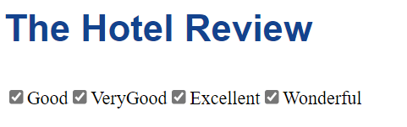
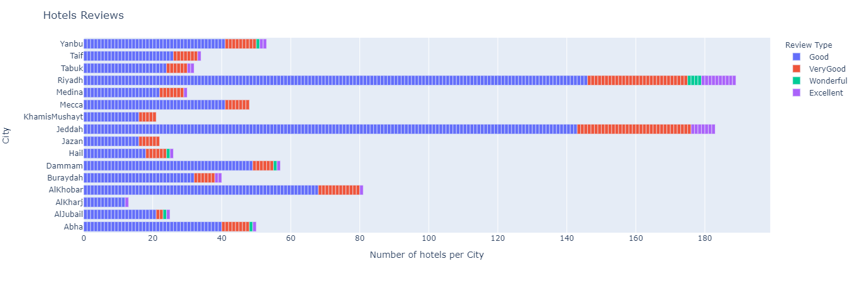

Slide 12

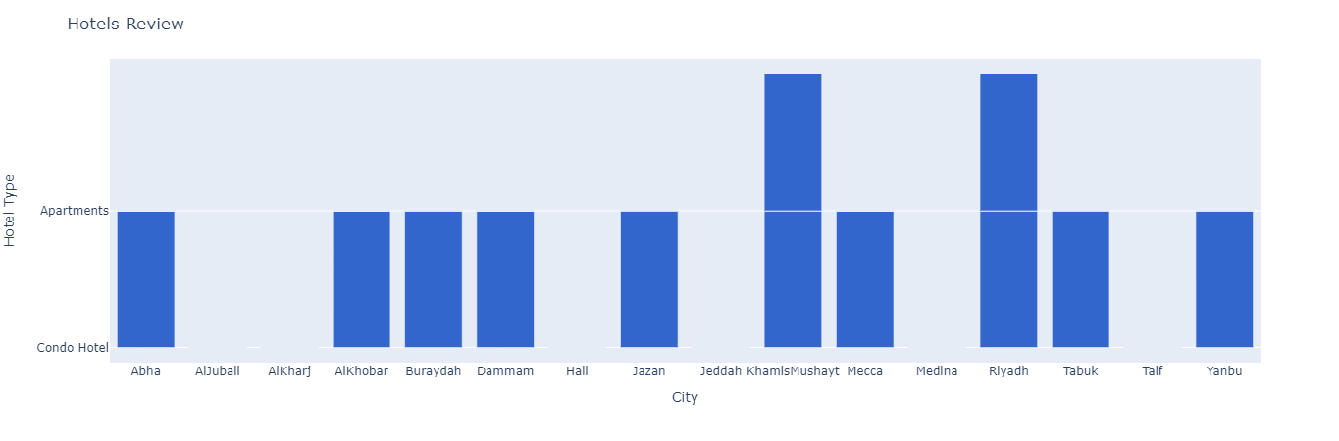
Exploratory Data Analysis (EDA)

Slide 13

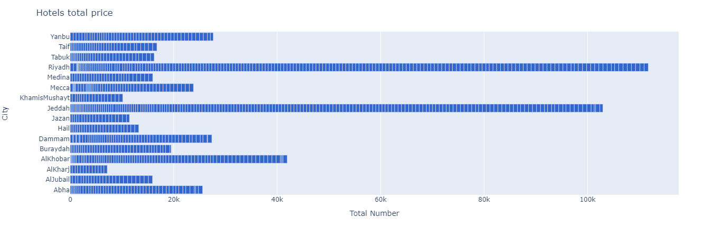
Exploratory Data Analysis (EDA)

Slide 14
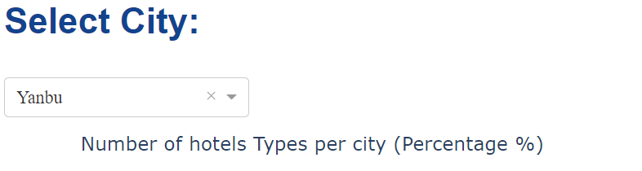
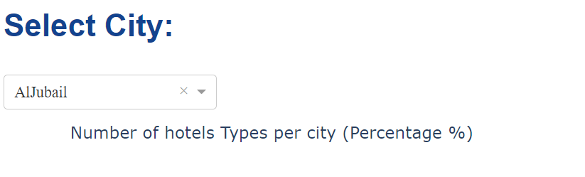
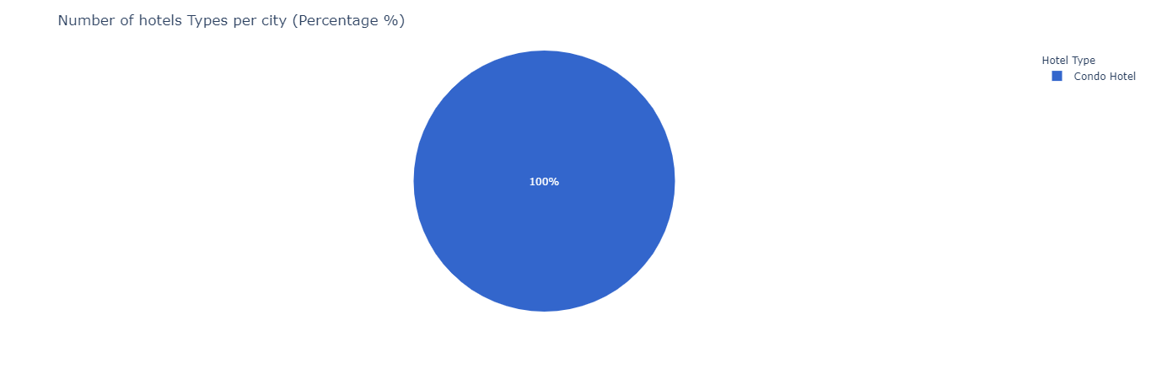
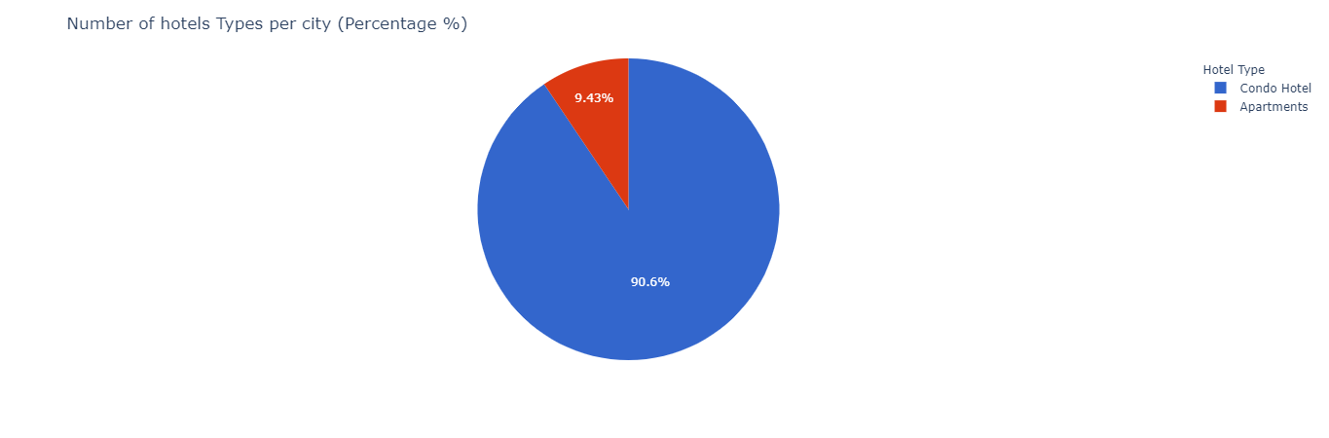
Exploratory Data Analysis (EDA)

Slide 15
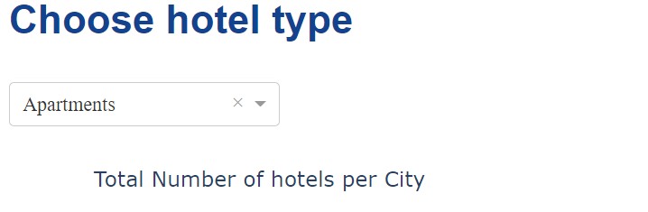
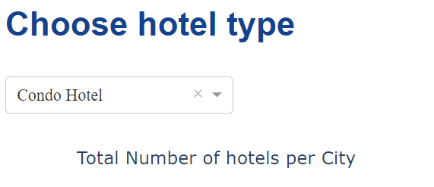
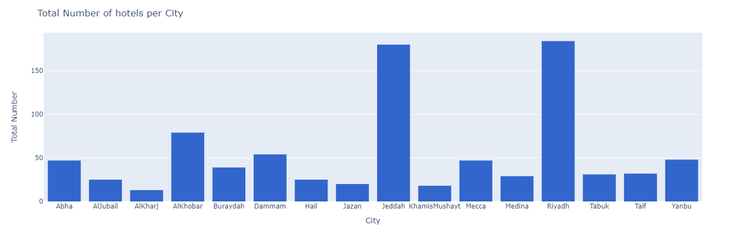
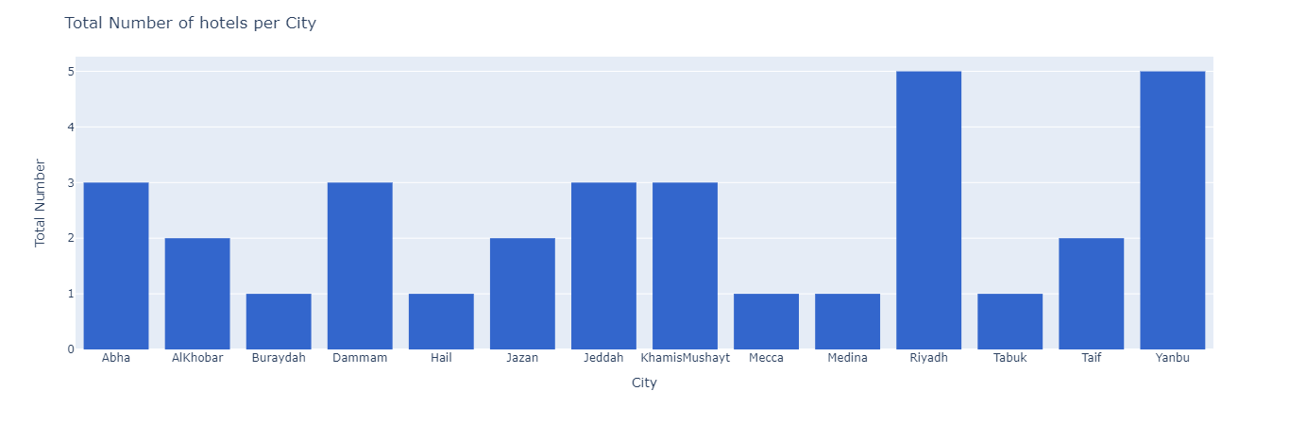
Exploratory Data Analysis (EDA)

Slide 16

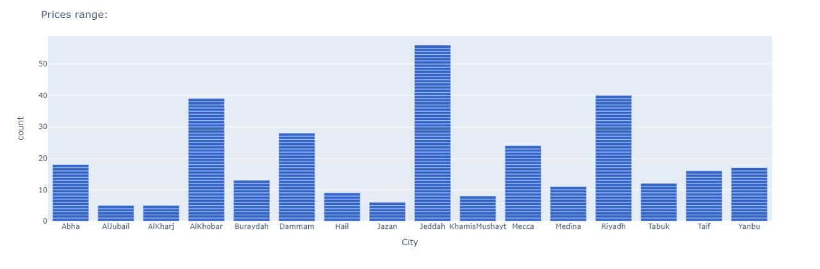
Exploratory Data Analysis (EDA)

Slide 17
Modeling

Slide 18
01
02
04
05
03
Split the data
Scaling the data
Random Forest
Regression
XGBoost Regression
Grid Search for
Regression

Slide 19
Results
The cost functions for RandomForestRegressor model are:
MSE = 506.86
MAE = 8.79
RMSE = 22.51
The cost functions for XGBoost Regression model are:
MSE = 656.76
MAE = 11.53
RMSE = 25.62

Slide 20


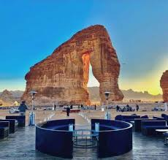
Conclusion and Future Work
For location that does not have apartment hotels, our model can give this a recommendation on whether to open it in these cities or not based on the market trends and historical data.
Also, we noticed based on all regression models we used in this project for hotel data the best cost functions results were for the RandomForestRegressor model.

Slide 21
Thank You for your attention
Any Questions?

